Slide 1
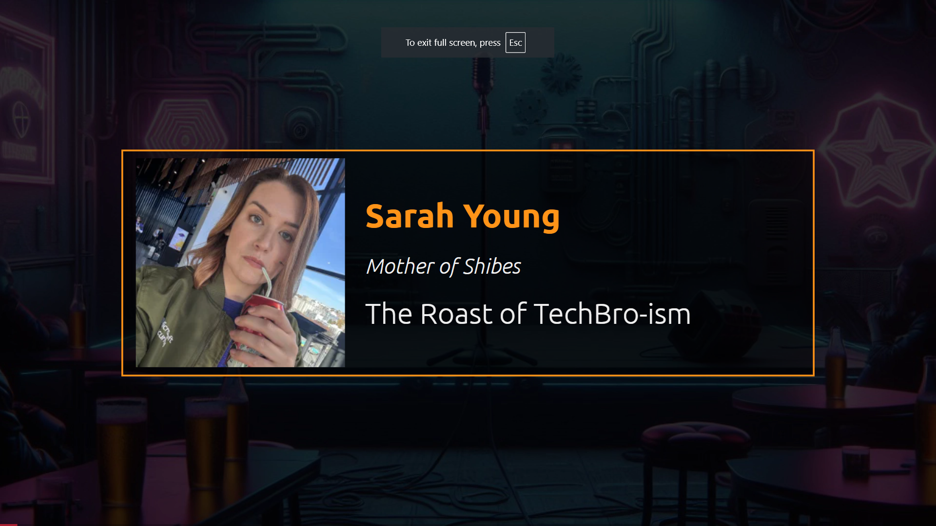

Slide 2
The roast of techbro-ism
Sarah Young

Slide 3
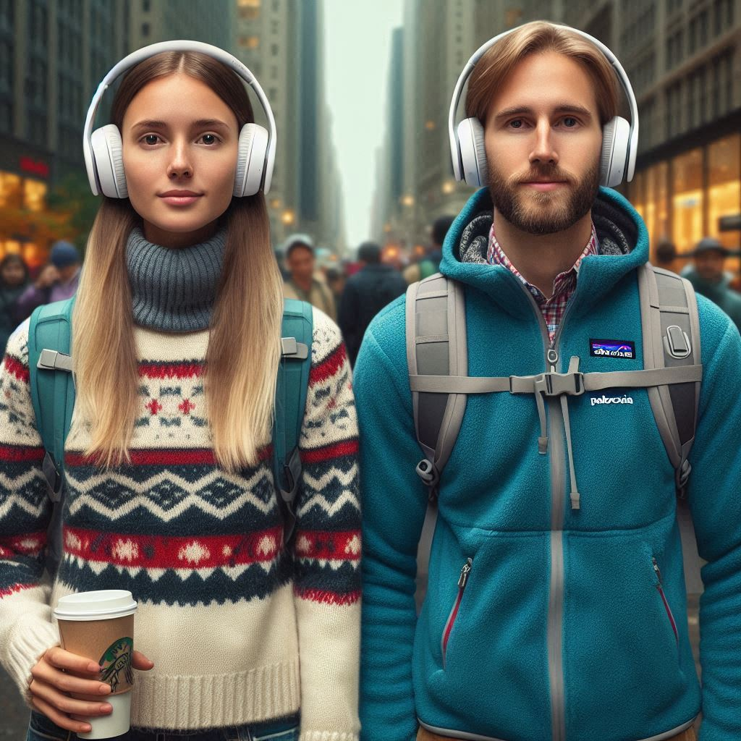
What is a tech bro*?
* Despite the wording, a tech bro can be any gender.

Slide 4
How will techbro-ism have evolved in 2034?
Must have your TC* tattooed on you
Compulsory wearing of Patagonia
Only eat from DoorDash or office free food
* Total comp = salary + bonus + stock

Slide 5
But the scariest thing about 2034?

Slide 6
From observing and monitoring tech folks and collecting data about everyone and spending too much time being trained by FAANG *
* FAANG is Facebook, Amazon, Apple, Netflix, Google
Notes:
Forget Skynet, this is infinitely worse

Slide 7
AI will have become a tech bro :/
Notes:
Forget Skynet, this is infinitely worse

Slide 8
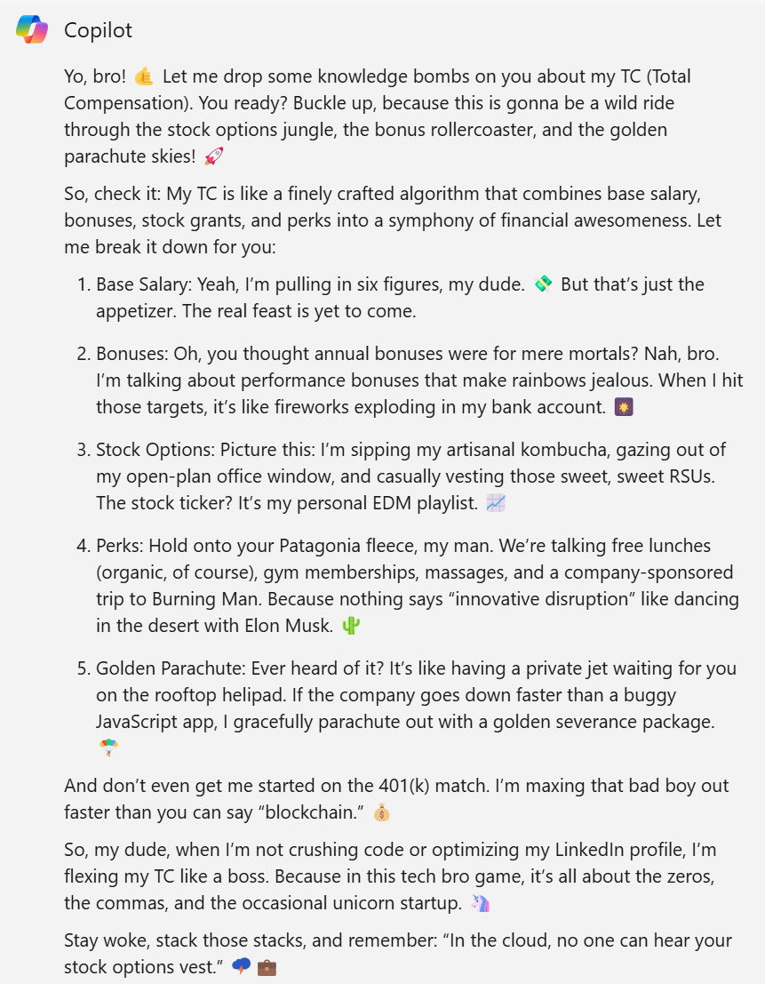
Notes:
Lets see what this looks like

Slide 9

Copilot for total compensation image
Notes:
Copilot for total compensation

Slide 10

Copilot for net worth
Notes:
Copilot for net worth

Slide 11

Notes:
Copilot for patagonia

Slide 12

Windows Recall new features

Slide 13
So, how can we stop this apocalyptic scenario from taking place?
Notes:
Forget Skynet, this is infinitely worse

Slide 14
Stop being a tech bro!
Notes:
Forget Skynet, this is infinitely worse

Slide 15
Stop flexing about your TC
Notes:
Forget Skynet, this is infinitely worse

Slide 16
Take your noise cancelling headphones off and speak to people
Notes:
Forget Skynet, this is infinitely worse

Slide 17
Go out into the real world and get some non tech friends
Notes:
Forget Skynet, this is infinitely worse

Slide 18
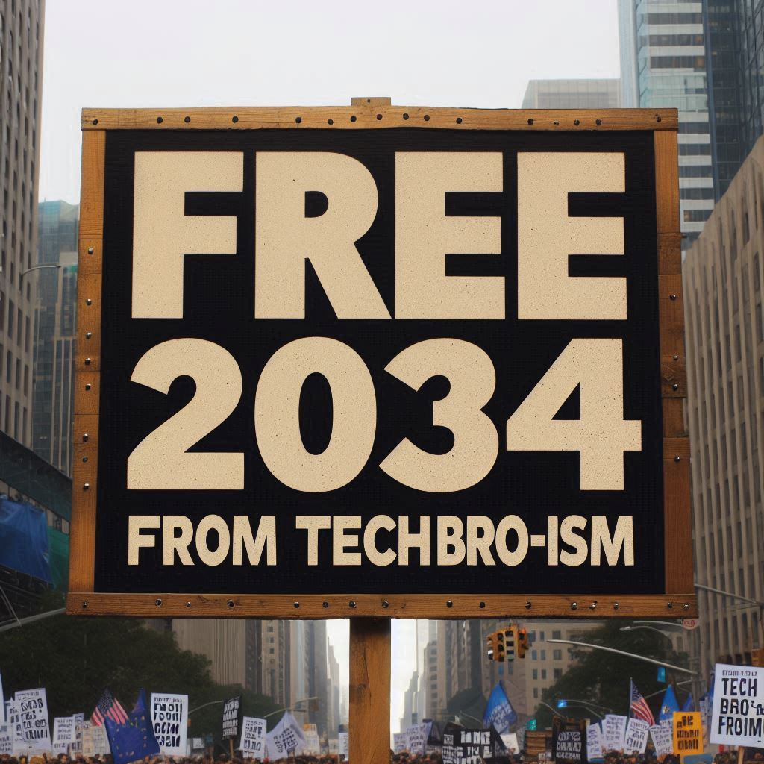
Notes:
Forget Skynet, this is infinitely worse

Slide 19
Remember that most folks in tech are very privileged compared with your average person and we sometimes forget that
Notes:
Forget Skynet, this is infinitely worse

Slide 20
Sorry to end on something slightly more serious
Notes:
Forget Skynet, this is infinitely worse

Slide 21
Thank you, PubConf! *
* I am guilty of most of these behaviours at some point in my life so please take this presentation in the spirit it is intended ☺
Notes:
Forget Skynet, this is infinitely worse

